Slide 1
Welcome to Fifth Grade A track
Mrs. Espinoza
Language Arts & Social Studies
Miss Wagoner
Math & Science

Slide 2
Contact
Mrs. Espinoza for Reading & Social Studies
kespinoza@cnusd.k12.ca.us
Miss Wagoner for Math & Science
lwagoner@cnusd.k12.ca.us
Remind Code (parent communication)
Espinoza’s Roster ONLY – text @87h9hk to phone # 81010
Wagoner’s Roster ONLY – text @eb97938 to phone #81010
Join only the roster that your child is on. Do NOT join both
Google Classroom Code (students only)
4b5aqaq (through student CNUSD account)
School Phone Number
(951) 738-2180

Slide 3
Rotating
Instructional Minutes – exactly split
Communication (both teachers depending on subject)
Home teacher (roster child is on)
Similar management and classroom expectations to keep from confusion
Gradebook (shared)
Espinoza – Reading Narrative & Social Studies
Wagoner – Math & Science
All other subjects are shared by both teachers

Slide 4
Rotating
Similar to Jr. High; rotating to different teacher for a different subject
Supplies/Materials
Minimal – keep the extra limited; will be carrying with them between classes
Backpacks - Binders, pencil pouches, notebooks
Desks
Shared with student from other roster
COVID – AM student will use the desk for storage & PM student will use the cubby *Desks will be cleaned at each rotation

Slide 5
Rotating
Schedule:
Monday, Tuesday, Thursday, Friday
AM Block 8:00 – 11:00 (including 10 min. recess & rotation time)
PM block 11:00 – 2:25 (including lunch break)
Wednesday (shorter day)
AM Block 8:00 – 10:00
PM Block 10:00 - 1:25 (including recess & lunch)
***The AM Block & PM Block will have the same amount of time with each teacher/subject***

Slide 6
Attendance/Homework
Be here and be on time
Make up work cannot replace hours of instruction
Please make every effort to schedule appointments and trips while we’re off track
Homework
Used to practice skills learned during the day
Please be checking, but not doing, your child’s work
Communicate with teacher as needed

Slide 7
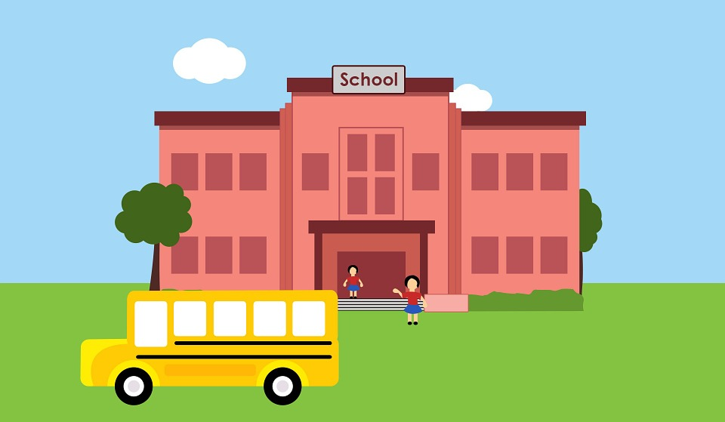
Elementary Attendance Criteria
1st Courtesy Notice - 7 events
2nd Warning Notice - 10 events
3rd SART Notice - 15 events
1 Event = 1 day of an
Absence,
Tardy,
Early-out

Slide 8
Progress Reports
WEEKLY FOLDERS
Sent home EVERY FRIDAY
Parents sign and return by Monday
Explains progress on behavior & homework throughout the week
Study Hall/Fun Friday – Students earn Fun Friday by completing all homework. Missing homework will be completed in study hall while others are at Fun Friday
ACADEMIC (Grades) – sent home periodically
Formal report will be sent home a few times per trimester, but graded work will be coming home weekly

Slide 9
Independence
We will be putting great deal of focus on independence and responsibility.
Kids are getting older and need to start learning how to do things more on their own without as much parent/teacher help.
It’s ok for them to make mistakes – they will learn from those mistakes.
Please don’t make excuses for them. Let them learn.

Slide 10
Discussion Word
Character building words, quotes, videos
Word & definition written down on Monday - Due on Friday
At some point during the week, student will discuss with a family member a meaning, life lesson, personal experience, etc. involving the word – both parents and students share during the discussion.
Write 2-3 sentence summary to share with class Friday

Slide 11
Behavior/Discipline
Positive and Negative Consequences
Gradual consequences
Communication home or principal’s office for consistent/continuous or major issues
Check Weekly Progress
Trust Us ☺
PBIS/PAWS

Slide 12
GENERAL HOUSEKEEPING
Doctor’s notes for injuries/illness (no PE)
Communicate/keep us in the loop
Dropping off items in the office
Keep to a minimum – trying to teach that responsibility ☺
Birthdays
No cupcakes, etc. (district policy)
Goodie bags are ok
Please check in with us first

Slide 13
Internet Access
Websites
Google Classroom
Remind
Discovery Education (Multiple Subjects)
Pearson Realize (Math)
Moby Max
i-Ready
Etc.

Slide 14
Grading Scale
97-100=A+
94-96=A
90-93=A-
87-89=B+
84-86=B
80-83=B-
77-79=C+
74-76=C
70-73=C-
67-69=D+
64-66=D
60-63=D-
0-59= F

Slide 15
Fifth Grade
Science Test – first time State Testing
Human Growth – how their own body is changing
Physical Fitness Test – mile run, push-ups, etc.
May try out for the following this year as a 5th grader; more info will come as these events occur
Band
Track
Math Field Day
Student Council
Spelling Bee

